Slide 1
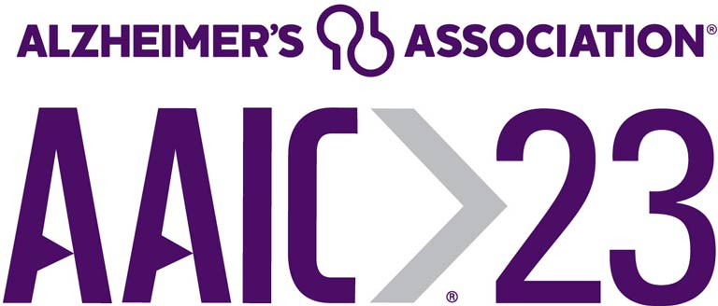
Neurophysiological activity linked to AD pathology relates to MCI progression
Jonathan Gallego Rudolf, Alex Wiesman, Sylvain Baillet, Sylvia Villeneuve, and the PREVENT-AD Research Group
Contact information: jonathan.gallegorudolf@mail.mcgill.ca
Background
Neurophysiological activity (MEG)
Aβ PET
Tau PET
The synergistic effects of pathological Aβ and tau accumulation disrupt neurophysiological activity
?
Aβ
Tau
Study aim
Can neurophysiological activity features extracted from rs-MEG predict progression from the asymptomatic to the MCI stage of AD?
Notes:
Good afternoon, everyone. It is a pleasure to be here at the AIC to present some of my research work.
Previous studies have shown that the synergistic effects of Ab and tau accumulation disrupt neurophysiological activity, which could be part of the mechanisms underlying the onset of clinical symptoms.
Ab and tau PET technology can accurately identify individuals at risk of progressing from the asymptomatic to the Mild Cognitive Impairment stage of AD, however PET imaging is invasive and expensive, which limits its accessibility.
The aim of our study was to test whether capturing early neurophysiological changes related to the pathological effects of Ab and tau could represent an alternative for predicting MCI progression.

Slide 2
Methods
Participants - PREVENT-AD cohort
103 participants with family history of sporadic AD (all cognitively unimpaired at enrolment).
Longitudinal cognitive follow-ups
20.4% MCI (mean time for progression 2.9 years).
Notes:
To answer this question, we used a subsample of participants from the PREVENT-AD cohort, comprising 103 asymptomatic individuals with family history of sporadic AD.
Longitudinal cognitive follow ups-have identified that around 20% of these participants have progressed to an MCI classification.

Slide 3
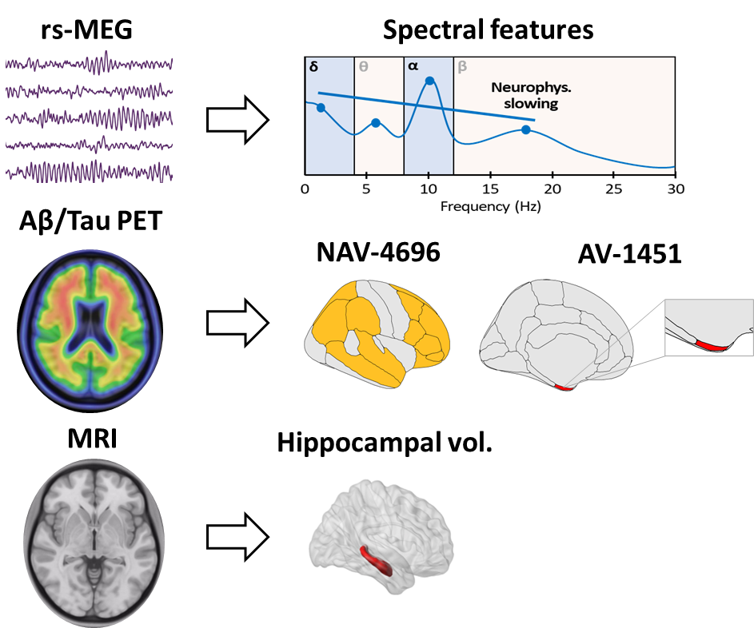
Methods
Participants - PREVENT-AD cohort
Multimodal neuroimaging
103 participants with family history of sporadic AD (all cognitively unimpaired at enrolment).
Longitudinal cognitive follow-ups
20.4% MCI (mean time for progression 2.9 years).
Notes:
All participants underwent resting-state Magnetoencephalography, Ab and tau PET and structural MRI at the time they were cognitively unimpaired.
We derived spectral power features from the resting-state MEG data, SUVR values from Ab and tau PET scans and hippocampal volume from structural MRI.

Slide 4
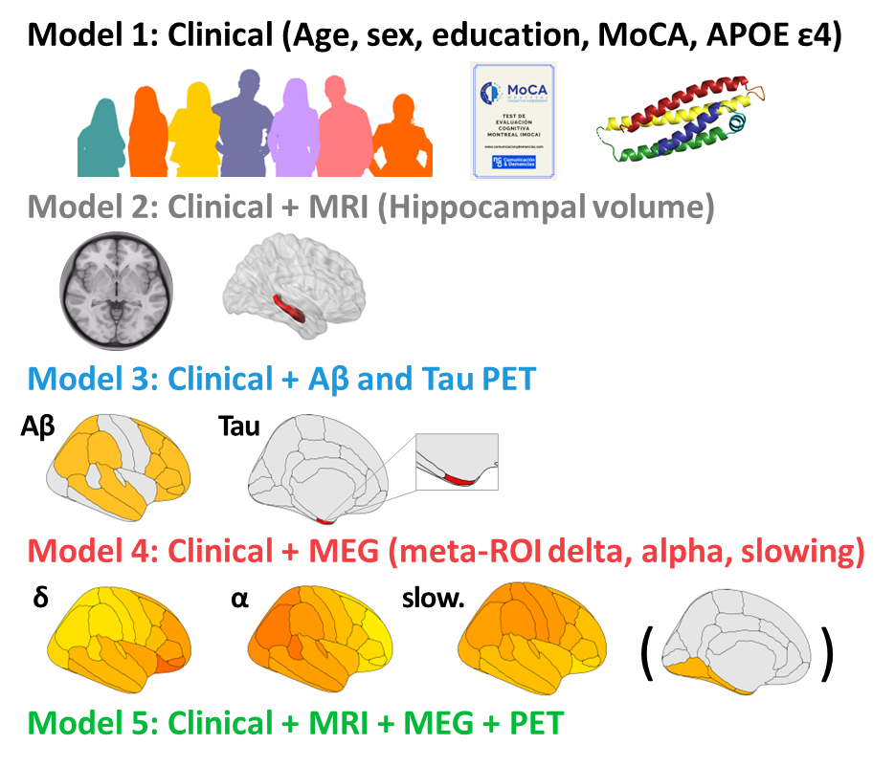
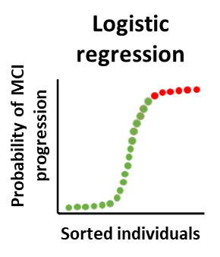
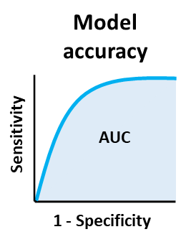
Methods
Logistic regression model comparison
Models for predicting MCI progression
MCI progressors (n=21)
Non-progressors (n=82)
Notes:
To assess the value of neurophysiological activity features for predicting MCI progression, we compared the accuracy of a series of predefined logistic regression models.
We started with a basic clinical model including age, sex, years of education, MoCA scores at screening and APOE status.
We subsequently added different neuroimaging features to this model, starting with hippocampal volume, then the Ab and Tau PET SUVR from early accumulating regions, and finally the spectral MEG features extracted from early tau accumulating temporal regions.

Slide 5
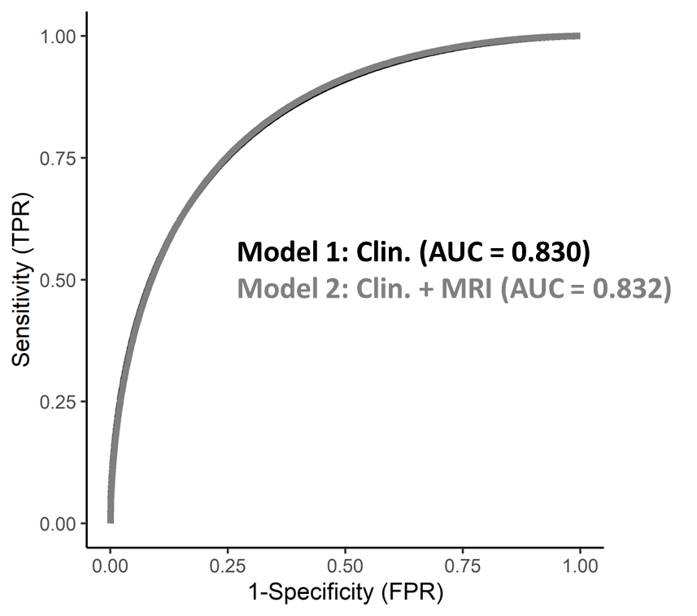
Results
Basic clinical and MRI features provide moderate accuracy for predicting MCI progression
( Clin = MRI)
Notes:
We found that the basic clinical model and the model incorporating structural MRI provided an accuracy of AUC = 0.83 for predicting MCI progression.

Slide 6
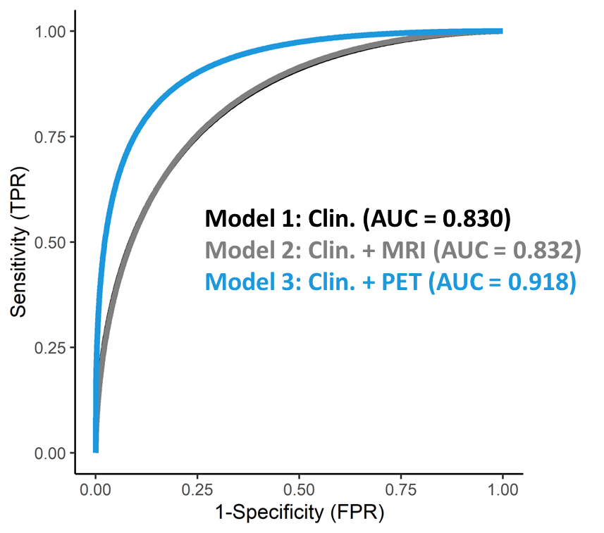
Results
The addition of Aβ and tau considerably increase the accuracy of the model
( Clin = MRI > PET )
Notes:
The combination of clinical features with Ab and tau PET (shown in blue) resulted in a considerable increase in accuracy, reaching an AUC of 0.91.

Slide 7
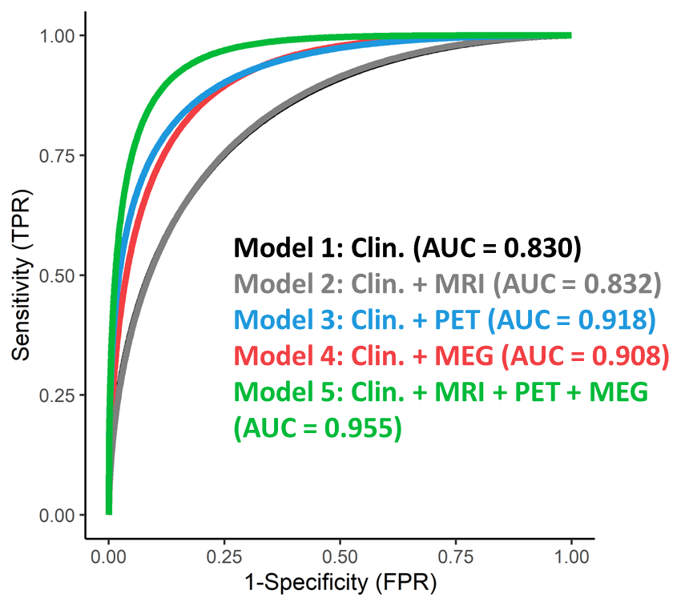
Results
Neurophysiological features match the accuracy provided by Aβ and tau PET
( Clin = MRI > MEG = PET > All )
Notes:
Importantly, spectral features derived from resting state MEG (shown in red) matched the accuracy provided by Ab and Tau PET. Combining all features into a single model reached a 95% accuracy, as shown in the green curve.

Slide 8
Results
Take home message
Neurophysiological activity features outperformed the clinical and structural MRI models, matching the accuracy of Aβ and Tau PET for predicting MCI progression.
MEG (and possibly EEG) could potentially serve as a screening strategy to select individuals for specialized invasive testing for AD pathology.
( Clin = MRI > MEG = PET > All )
Notes:
In summary, we found that neurophysiological features extracted from rs-MEG outperformed the clinical and structural MRI models, and matched the accuracy provided by PET for predicting MCI progression in our cohort.
Neurophysiological activity features extracted from MEG, and possibly EEG, could potentially be used as a screening tool for identifying individuals for specialized invasive testing for AD in asymptomatic older adults.

Slide 9
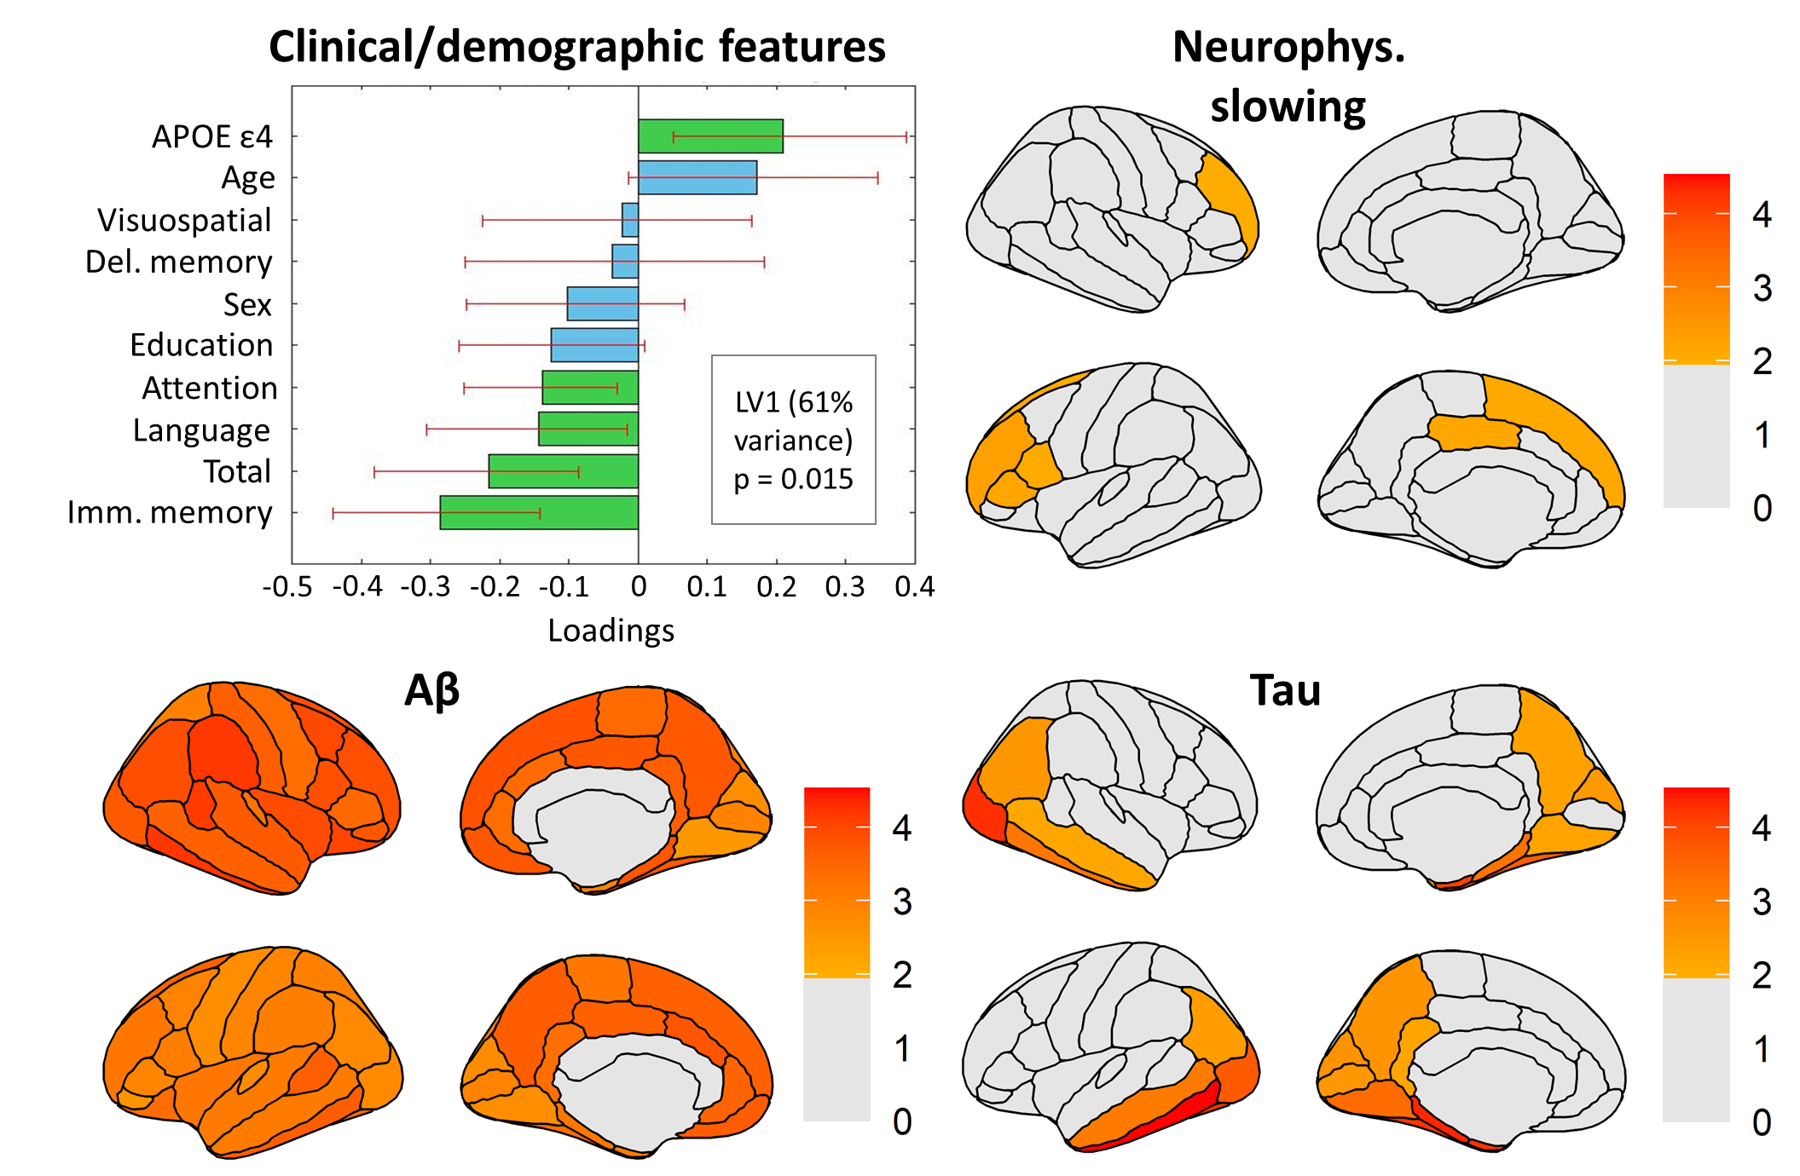
Results
( Clin = MRI > MEG = PET > All )
Visit my poster on Monday!
P2-07–Biomarkers: Neuroimaging # P2-450
Notes:
If you want to know more about this and the rest of the analysis from my project, I’ll be happy to discuss it with you during my poster presentation on Monday.

Slide 10
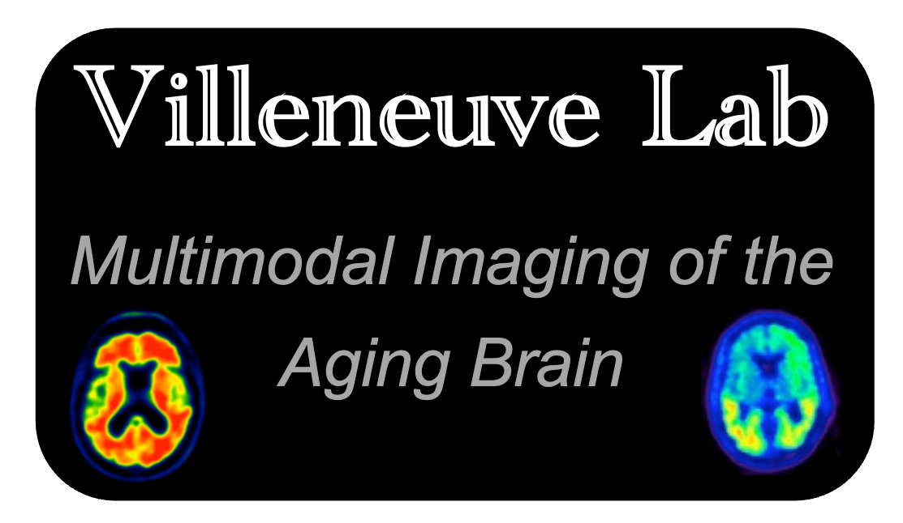
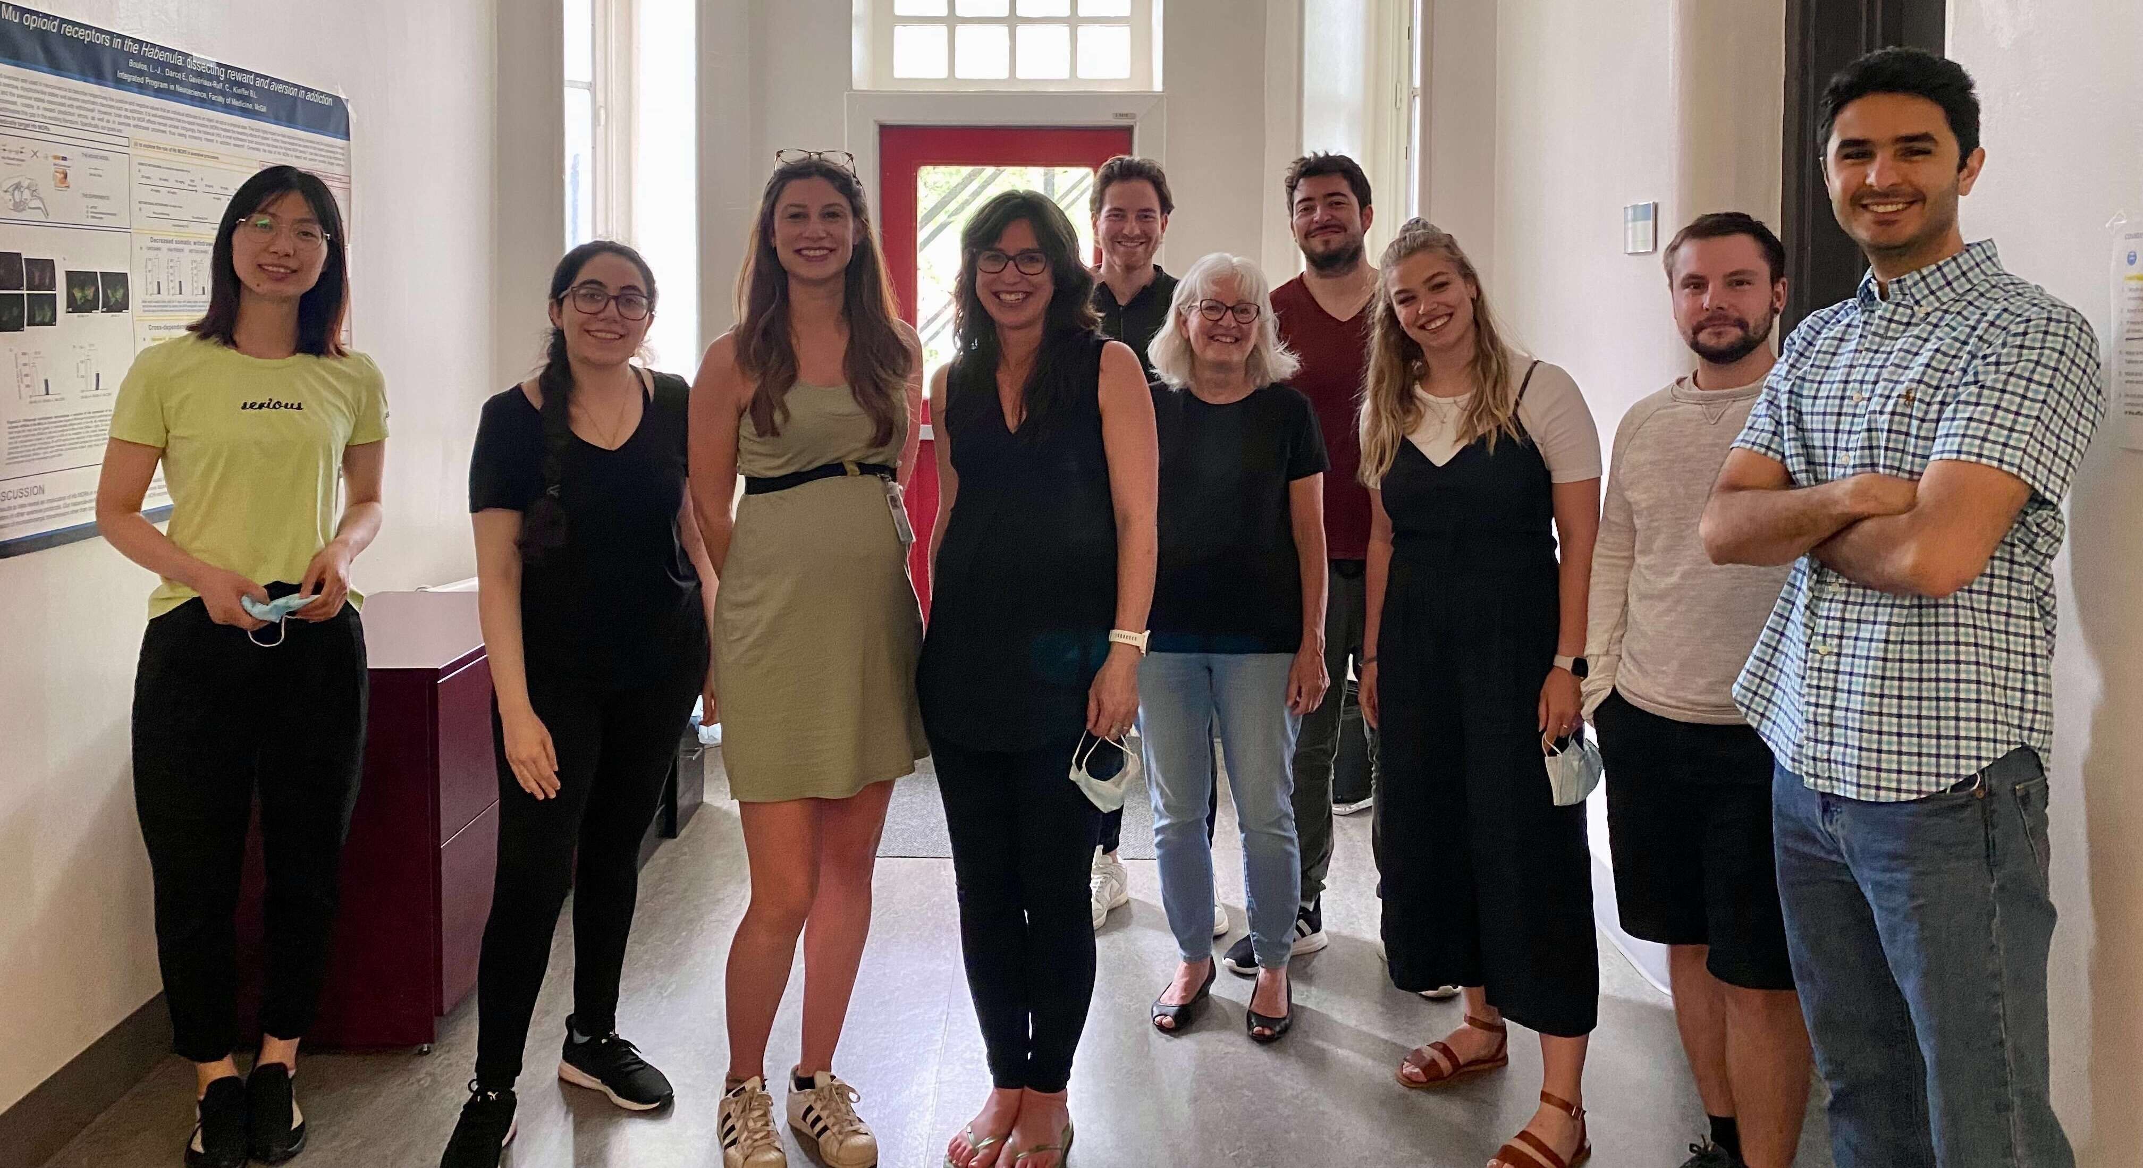
Take home and acknowledgements
PI: Dr. Sylvia Villeneuve
PI: Dr. Sylvain Baillet
Notes:
I would like to conclude by thanking the people from the Villeneuve and Baillet labs at McGill University for their contribution and feedback provided for this research project. Thank you for your attention!

